Slide 1
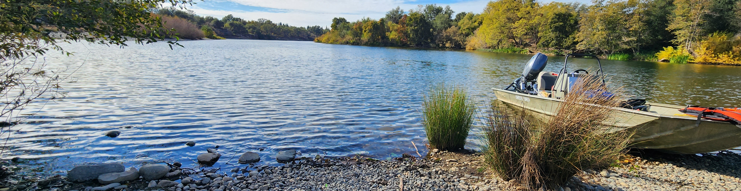

Potential updates to CR Metrics and Methods
August 5th, 2026

Slide 2
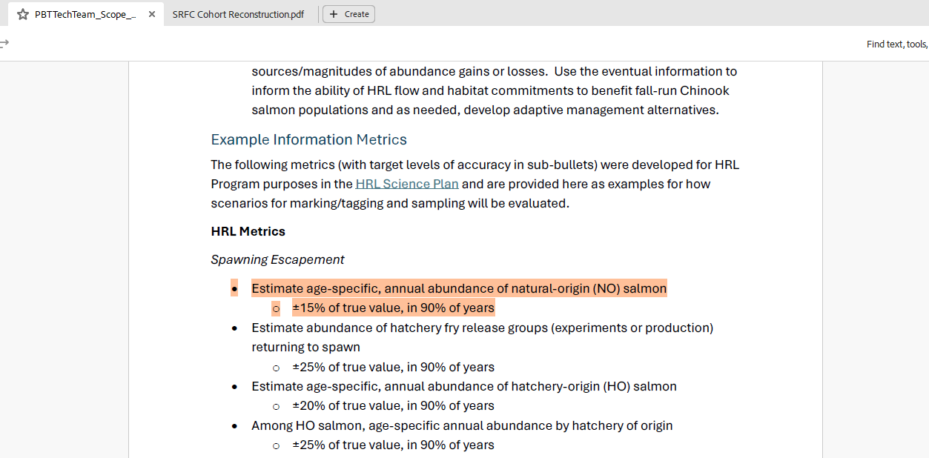

Slide 3
Sampling Questions
Sample Size: How many scales do we need to sample from recovered fish to accurately estimate the proportion of age classes in natural origin fish?
Sample Pooling: Instead of collecting some minimum number of samples from each tributary and hatchery, what if we just pooled samples across the Sacramento River basin to produce a single cohort reconstruction (CR) value? What is lost by doing this? What are the assumptions and what happens if we violate them?

Slide 4
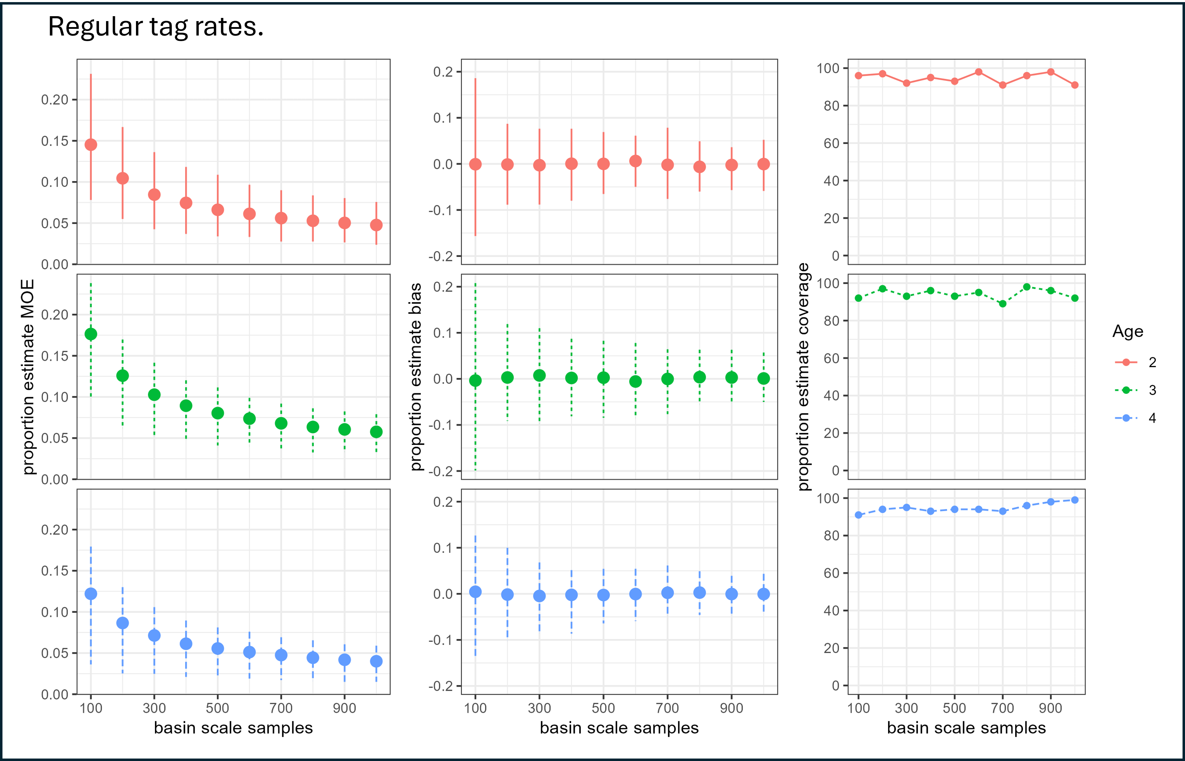
Notes:
Running a bunch of different simulations using this method, I found that 500 scales is a good minimum that provides an unbiased estimate within a 10% margin of error that accurately includes the true values around 95% of the time.
Proportion estimate coverage = in what proportion of our simulations was the true value within the estimated confidence intervals?

Slide 5

The good news?
The math and simulations work the same, ${\hat{p}}_{no,a}$ is derived from ${\hat{N}}_{no,a}$
$${\hat{p}}_{no,a}=\frac{{\hat{N}}_{no,a}}{{\hat{N}}_{no}}$$

Slide 6

The bad news?
${\hat{p}}_{no,a}$ is ambivalent to the size of ${\hat{N}}_{no}$
Currently our decision on the number of scales to collect comes from accuracy metrics of ${\hat{p}}_{no,a}$ not ${\hat{N}}_{no,a}$.
≈

Slide 7
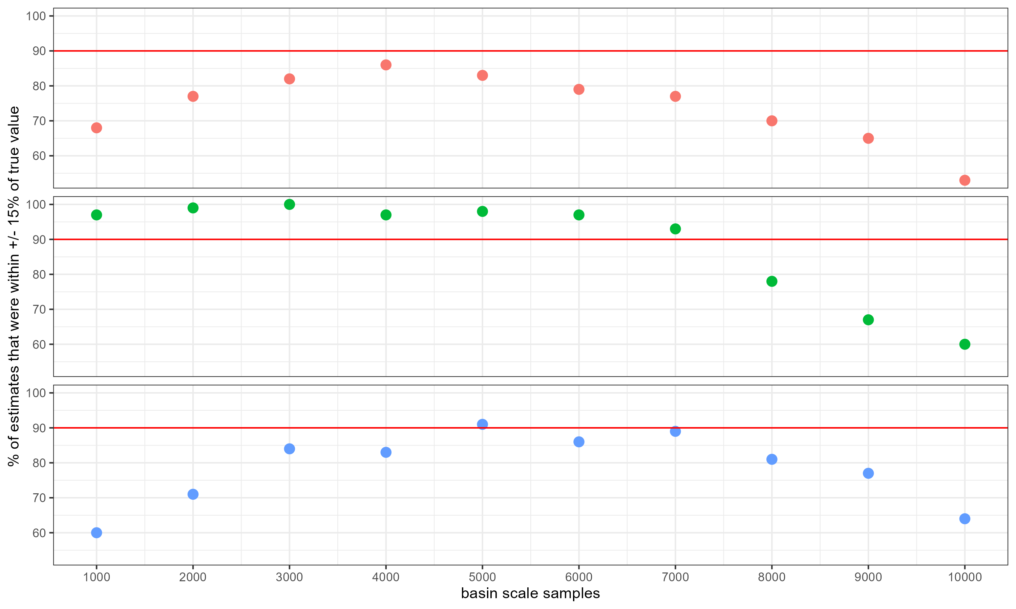
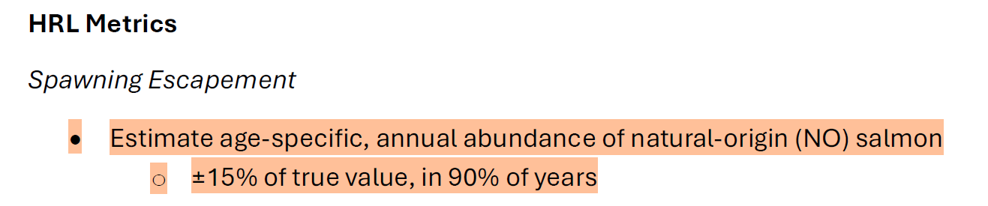
The number of scales we age does little for the accuracy of ${\hat{N}}_{no,a}$
Notes:
X-axis: number of scales pooled and aged across the basin
Y-axis: the percent of iterations that produced an estimate of abundance for that age class of natural-origin fish that was within +/- 15% of the true value

Slide 8
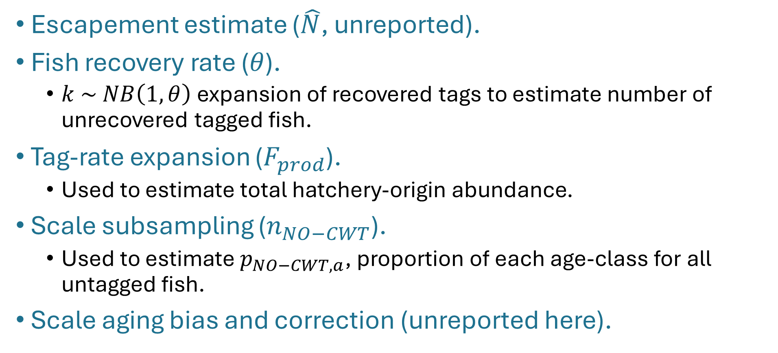
CR sources of uncertainty
Escapement estimate ($\hat{N}$, unreported).
Fish recovery rate ($θ$).
$k \sim NB\left(1,θ\right)$ expansion of recovered tags to estimate number of unrecovered tagged fish.
Tag-rate expansion ($F_{prod}$).
Used to estimate total hatchery-origin abundance.
Scale subsampling ($n_{NO−CWT}$).
Used to estimate $p_{NO−CWT,a}$, proportion of each age-class for all untagged fish.
Scale aging bias and correction (unreported here).
Notes:
Scale sample size has limited impact on uncertainty of abundance estimates for each age-cohort, and limited returns past a certain point when pooling across the basin. Tag-rate is the source of abundance uncertainty that we have the most ability to control.

Slide 9
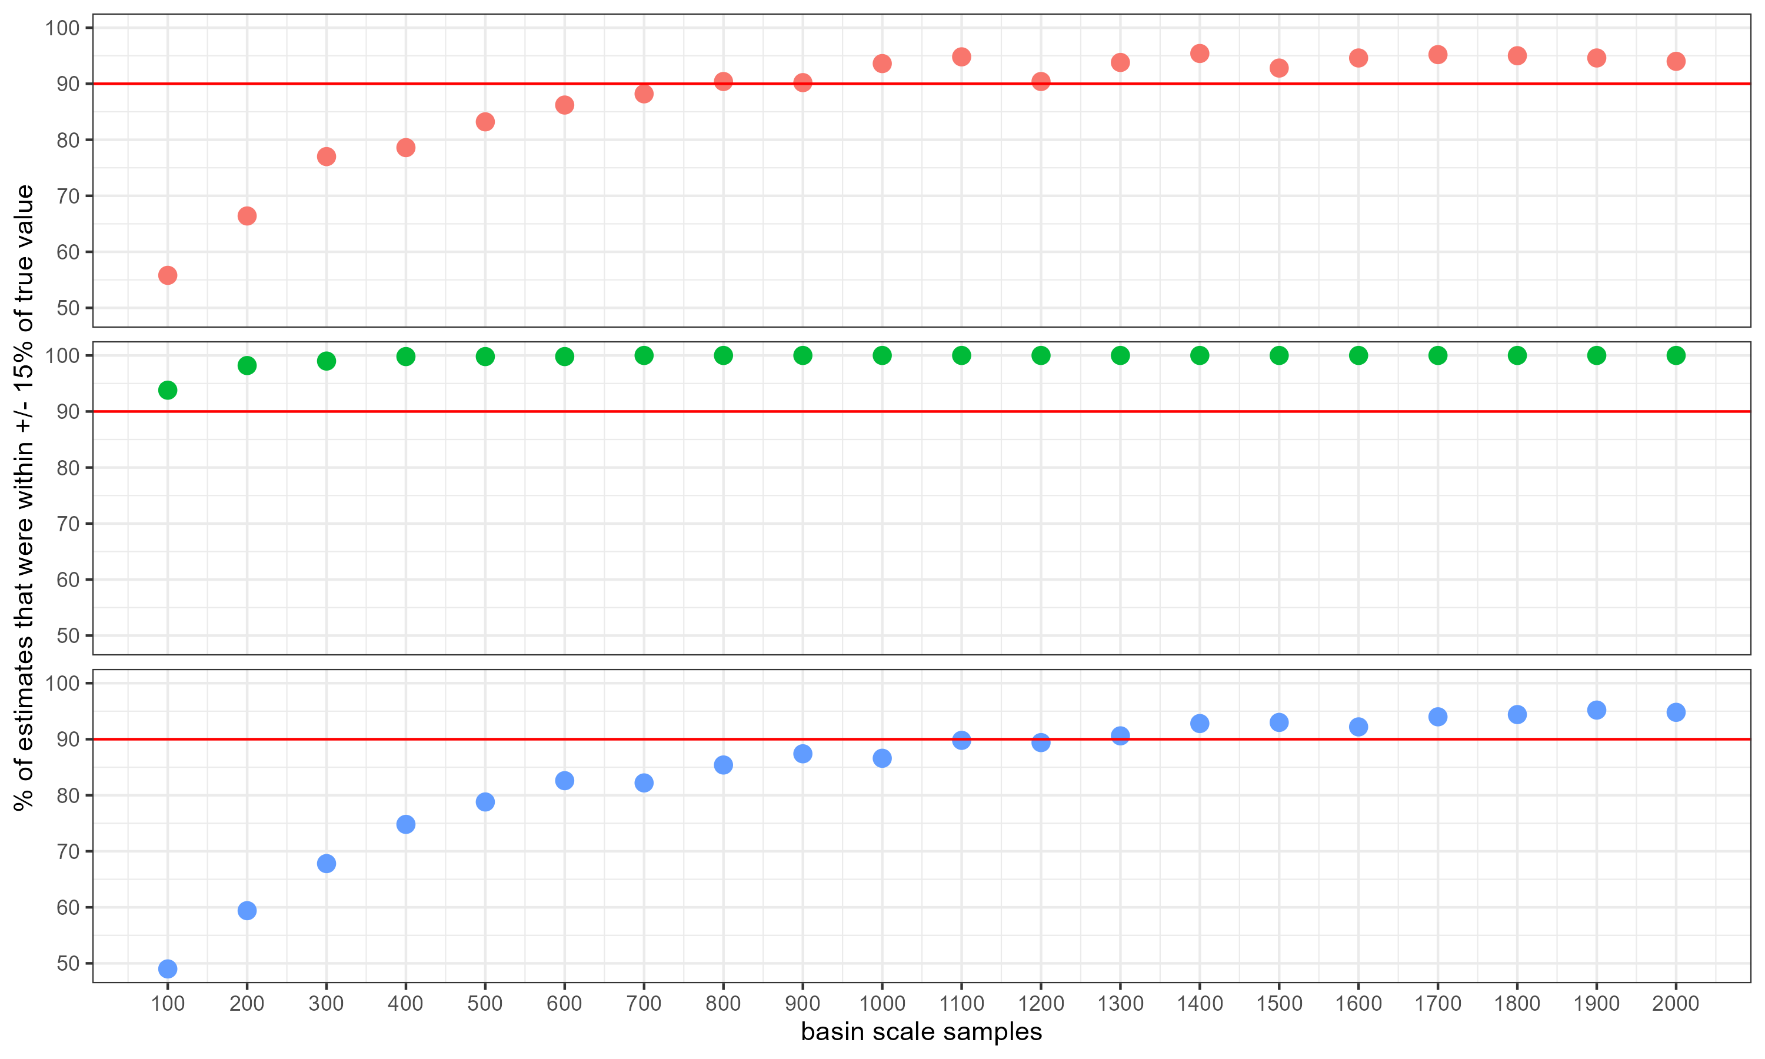
If we set tag-rate to 100%:

Slide 10

Take aways
If we our target metric is ${\hat{p}}_{no,a}$, then no issue!
However, if our target metric was supposed to be ${\hat{N}}_{no,a}$ ±15% then we should incorporate 100% tagging through PBT to get more accurate estimates and increase scale sample size to ~1500 scales.

Slide 11

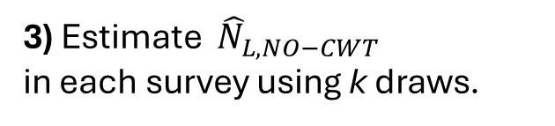


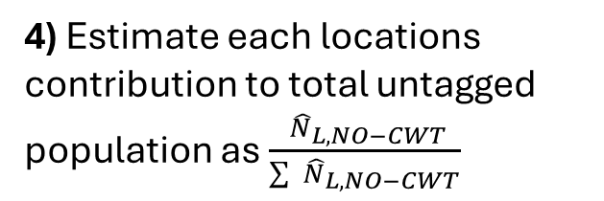
$L=$American R.
1) Escapement surveys
2) Collect scales in an unbiased and representative manner (every n^{th}) .
150 scales
3) Estimate ${ \hat{N}}_{L,NO−CWT}$
in each survey using k draws.
${ \hat{N}}_{L,NO−CWT}$=1500
4) Estimate each locations contribution to total untagged population as $\frac{{ \hat{N}}_{L,NO−CWT}}{\sum{{ \hat{N}}_{L,NO−CWT}}}$
${\hat{p}}_{L,NO−CWT}$= 1500 / 7500= 20%
5) Select 500 scales for aging
0.2*500=100
6) Pool scales for basin wide estimate
Basin-wide estimate

